Slide 1




Slide 2
What if your life depended on something you cannot buy?
Something you can only get
through somebody else’s will.

Slide 3
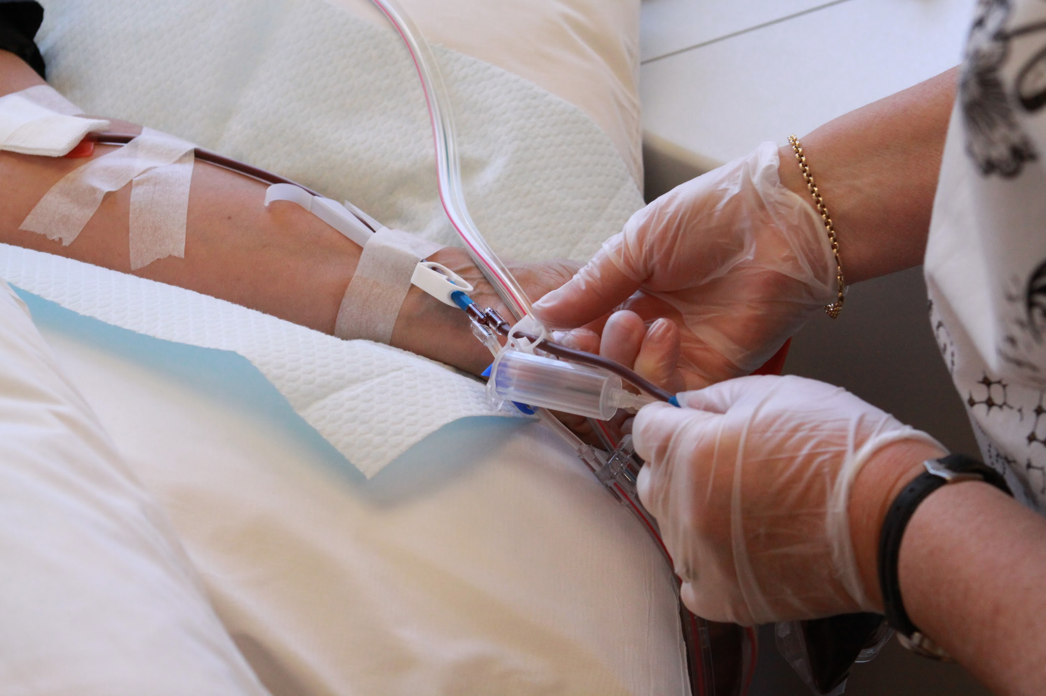
The problem:
People don’t donate blood in Brazil.

Slide 4
The problem:
People don’t donate blood in Brazil.
2012
~19 donations/
1000 habitants
~62% voluntary donations
Recommended:
30
73 countries get over 90%

Slide 5
The problem:
People don’t donate blood in Brazil.
Why?
Family/Friends in need
Lack of information/Misinformation
Lack of incentive
Fear

Slide 6
The other side
What are the the triggers?
Convenience
Replacement
Friend’s invitation
Sensitivity

Slide 7
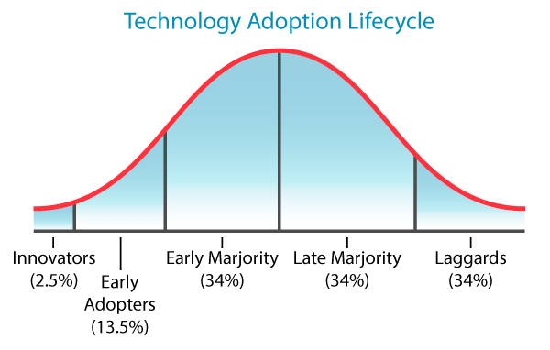
The concept
How can technology help?
~41% of donors are 18-30y.o.
~65% of 18-30y.o. people are internet users
focus on donors to engage friends

Slide 8
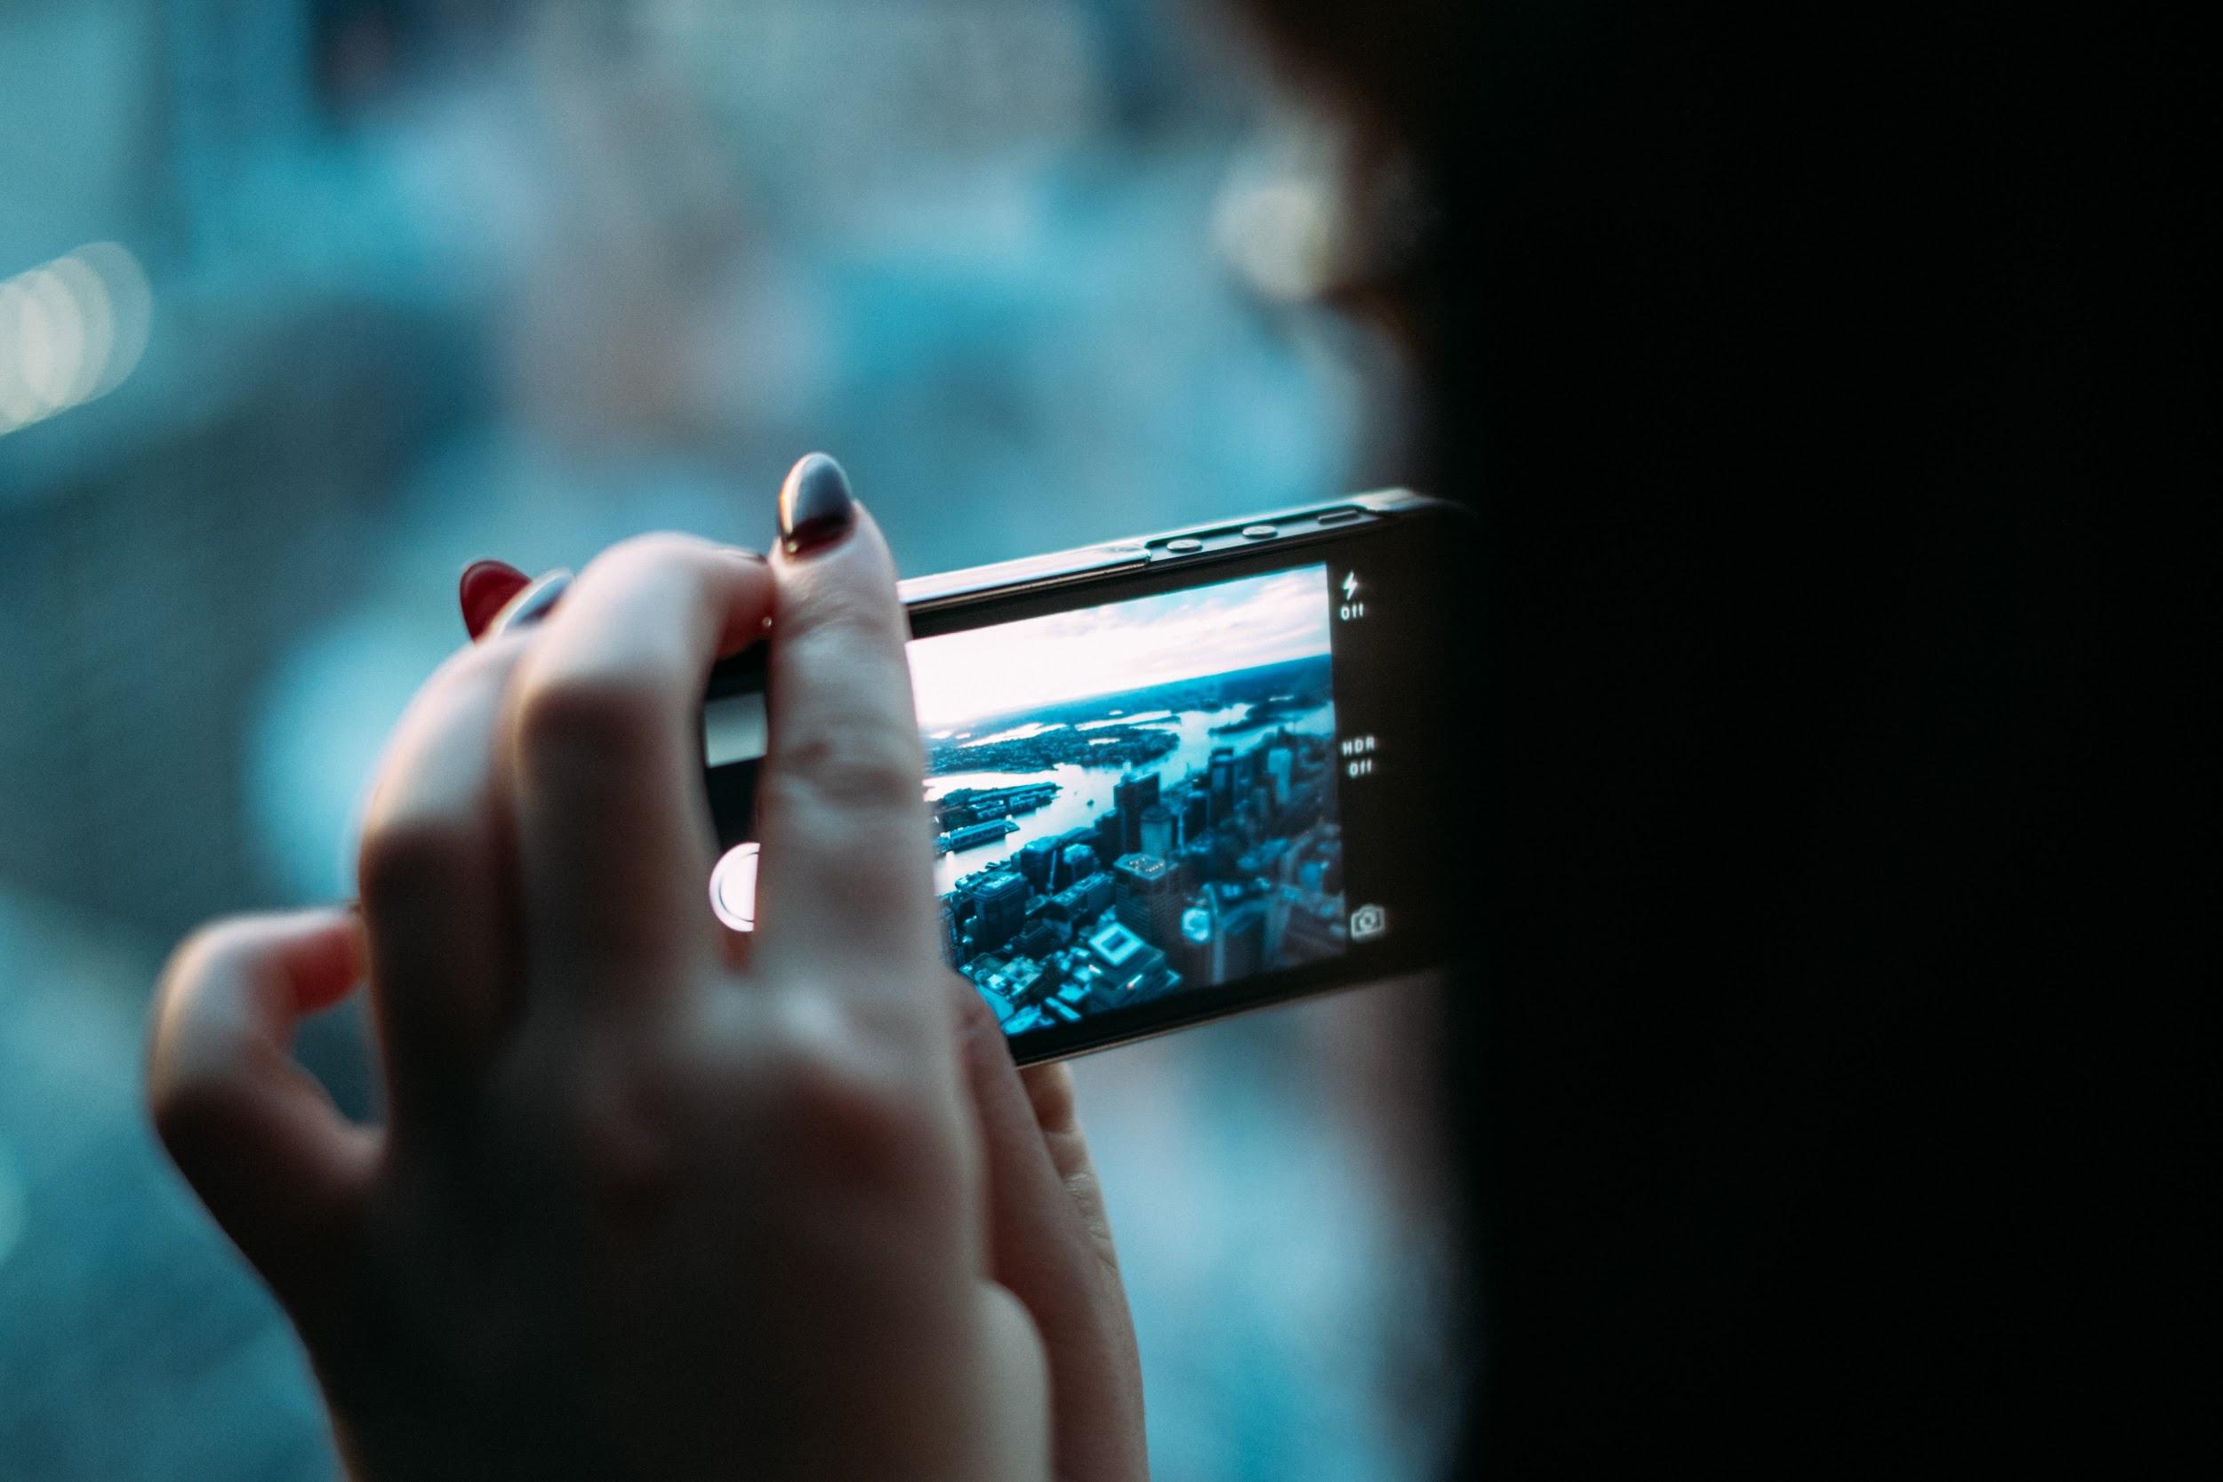
HOW?

Slide 9
Is this going to work?
YES!

Slide 10
Is this going to work?
Each invitation addresses a profile.
Social
A day to experience with a friend.
Sensibility
Adds convenience to will
Challenge
Counter-acts fear with fun
Dating
Engage teenagers with fun

Slide 11
Is this going to work?
For each problem, a solution
Misinformation
Informative Quiz
Lack of incentive
Social/Fun/
Challenge factor
Fear

Slide 12
Is this going to work?
It’s not only about blood donation.
Donors
Newcomers
Reminder for next donation
Engagement is Fun&Emotional
Rewarding experience
Rewarding experience

Slide 13
Has it been done before?
Other apps focus on the individual, not the social aspect
Blooder
Hemoliga
Donors meet Patients
Reminder for donation and geolocation
Humanizing
Blood bank inventory

Slide 14
The future
Where does it go from here?
Financing options: ~R$5k
First tests: existing base Sangue Corinthiano
Full methodology and code documentation
Can be applied to other causes

Slide 15
tempo bom para o bem

Slide 16

Digital WorldSkills Challenge 2015
Our Challenge:
Blood Donation Awareness
Milton Oliveira | CEO
milton@sobrevivencia.org.br
Vinicius Alves | PR
vinicius@sobrevivencia.org.br

Slide 17
Thank you!
#RedTeam
Andrew Seeley | iOS Developer @IBM
andrew@seemuapps.com
Diogo Doreto | Full Stack Developer
diogo.doreto@gmail.com
Jessica Tarasoff | UX/UI
jessicatarasoff@gmail.com
Mateus Paulino | Front-End Engineer
mateus.santos@oglobo.com.br

